Slide 1
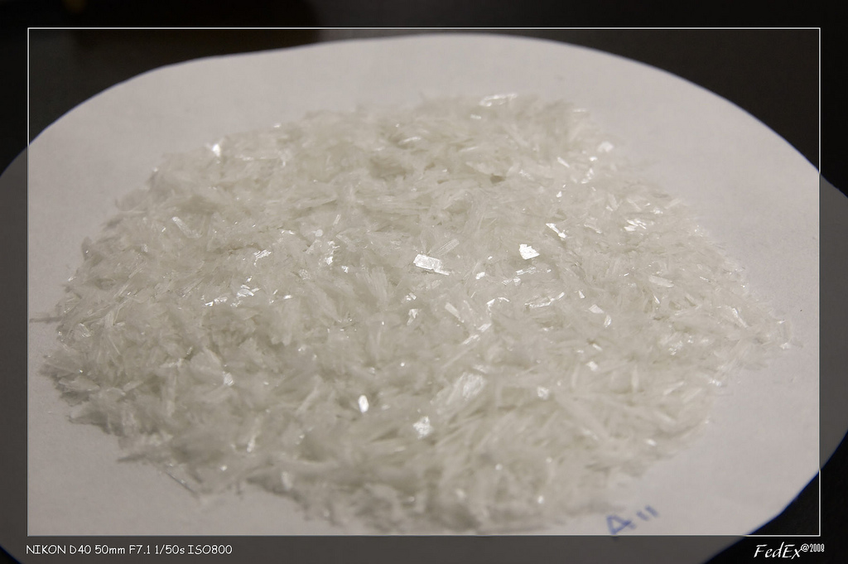
Synthesis of acetanilide

Slide 3
Side effect of acetanilide
Methemoglobin (Met Hb)

Slide 4
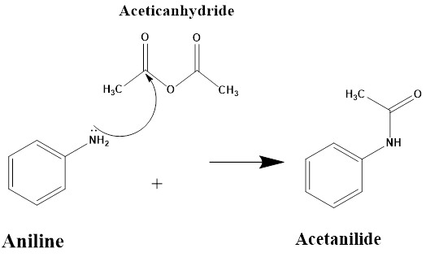
In this experiment, acetanilide would be prepared from aniline by acetylating it with acetic anhydride in the presence of concentrated Hcl and un hydrous Sodium acetate

Slide 5
Principle
Both aniline & acetic un hydride are somewhat viscous liquids, so simply mixing them together does not result in the efficient formation of acetanilide.
Therefore, a solvent is used (water) to dissolve and evenly disperse the reactants in it.
Aniline is not soluble in water, so concentrated HCl is added in order to dissolve it.

Slide 6
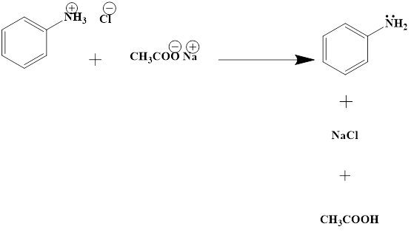
Only the free aniline can act as nucleophile, why?
Therefore, Sodium acetate will used in order to shift the reaction below to the left.

Slide 7
Scheme of reaction

Slide 8
Procedure
Conical flask A 1
Mix (2ml) of aniline with (4ml) of distilled water & drop wise of concentrated HCl.
Conical flask B 2
Dissolve (2.4gm) of un hydrous sodium acetate in (10ml) of distilled water, then add (6ml) of acetic anhydride.
3- Immediately Transfer the content of conical flask B to the content of conical flask A with shaking.
4-Cool the mixture (fridge) or add crushed ice until white crystals start to precipitate.
5-Filter the product and wash it with water.
6-Re crystallizes the acetanilide with minimum volume of hot distilled water, and then filters it.
7-Allow the product to dry at room temperature.
8-Calculate the percent of yield.

